Slide 1
Number Game
This C# project is a Number Guessing Game where the computer randomly selects a number between 1 and 100, and the user tries to guess it. Here's a detailed breakdown of the project:

Slide 2
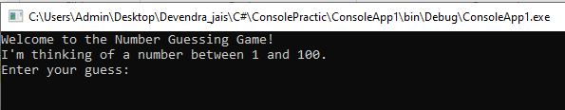
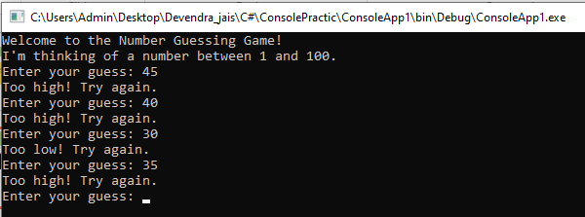
Main Components

Slide 3
1.Random Number Generation:
The game uses the Random class to generate a random integer between 1 and 100.
The generated number is stored in the variable numberToGuess.

Slide 4
2.Game Loop:
The game continues to prompt the user for guesses until the correct number is guessed.
A while loop is used with the condition !guessedCorrectly to keep the game running until the correct guess is made.

Slide 5
3.User Input and Validation:
The program asks the user to input their guess.
The input is validated using int.TryParse to ensure that the user enters a valid number.
If the input is not a valid number, the program notifies the user and asks again.

Slide 6
4.Guess Evaluation:
Each valid guess increments the number Of Tries counter.
The program compares the user's guess to the number To Guess:
If the guess is too low, the user is informed with "Too low! Try again."
If the guess is too high, the user is informed with "Too high! Try again."
If the guess is correct, the game congratulates the user and displays the total number of tries.

Slide 7
Code Structure:
* Namespaces and Class Declaration:
The program begins with the usual using directives for required namespaces.
It is defined within a namespace (here, ConsoleApp1).
The class ProNumberGame contains the Main method, which is the entry point of the application.

Slide 8
* Main Method Workflow:
1.Initialization:
A Random object is created to generate the number.
Variables for number To Guess, number Of Tries, and a boolean guessed Correctly are initialized.

Slide 9
2.User Interaction:
The game welcomes the user and explains the objective.
Within the loop, the program continually prompts the user to guess the number.
3.Input Handling:
The user's input is read and validated.
If the input is a number, the game checks whether it is lower, higher, or equal to the target number.

Slide 10
4.Ending the Game:
When the correct number is guessed, guessed Correctly is set to true, breaking the loop.
A congratulatory message is displayed with the total number of attempts.

Slide 11
Possible Enhancements:
* Range Customization:
Allow the user to specify a range for the random number.
* Difficulty Levels:
Introduce different difficulty levels which could limit the number of tries or adjust the range.
* Replay Option:
After a correct guess, prompt the user to play again without restarting the application.
* User Interface Improvements:
Enhance the user interface with more detailed instructions or a GUI using Windows Forms or WPF.

